Slide 1
SEQUENCE AND COLLABORATION DIAGRAM

Slide 2
INTERACTION DIAGRAM
models describe how groups of objects collaborate in some behavior
NOTE THAT: not class
typically, captures the behavior of a single use case
Two kinds
  sequence diagrams
  collaboration diagrams

Slide 3
an Order
Entry window
an Order
an Order
Line
a Stock Item
prepare()
*prepare()
hasStock:=
check()
object
message
condition
iteration
[hasStock]
remove()
needsReorder:=
needsToReorder()
self call
return
a Reorder
item
return
[needsReorder]new
a Delivery
Item
[hasStock]new
deletion
Creation

Slide 4
WHEN TO USE SEQUENCE DIAGRAM
One of the hardest things to understand in an object-oriented program is the overall flow of control.
A good design has lots of small methods in different classes and at times it can be tricky to figure out the overall sequence of behavior
Sequence diagram helps you see the sequence
valuable for concurrent process

Slide 5
Concurrent processes and activation
a Transaction
new
a Transaction
coordinator
a first
Transaction
checker
new
new
a second
Transaction
Checker
new
asynchronous
message
OK
all
done
other
processing
suppressed
OK
be Valid
all
done

Slide 6
SEQUENCE DIAGRAM
請看一下下面兩張sequence diagram

Slide 7
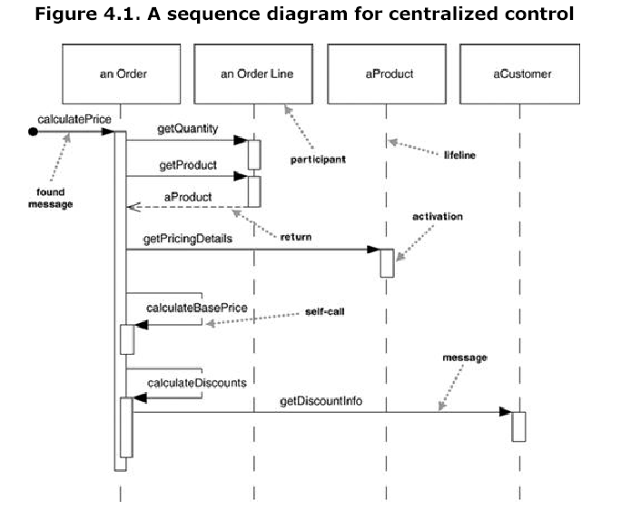

Slide 8
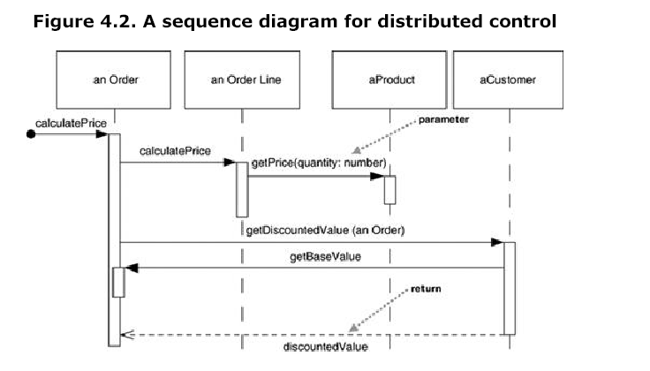

Slide 9
COMMENTS
Sequence diagram 並不擅長展示有 loop 等的演算法
適合展示某個複雜的互動情境

Slide 10
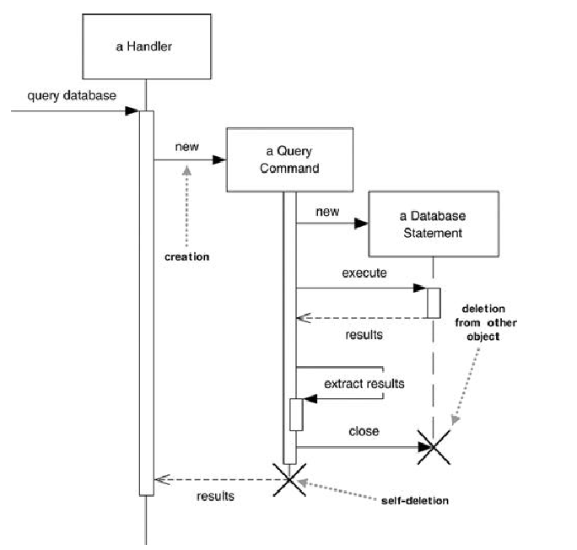

建立與刪除物件

Slide 11
COMMENTS
Sequence diagram 並不擅長展示有 loop 等的演算法
適合展示某個複雜的互動情境
Loops, Conditionals, and the Like
A common issue with sequence diagrams is how to show looping and conditional behavior. The first thing to point out is that this isn't what sequence diagrams are good at. If you want to show control structures like this, you are better off with an activity diagram or indeed with code itself. Treat sequence diagrams as a visualization of how objects interact rather than as a way of modeling control logic.

Slide 12
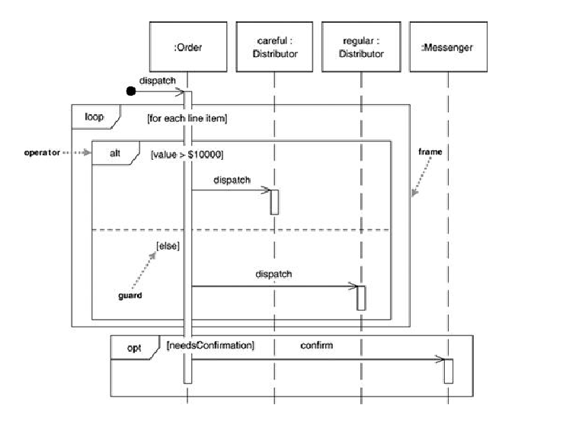

Slide 13
procedure dispatch
  foreach (lineitem)
  if (product.value > $10K)
  careful.dispatch
  else
  regular.dispatch
  end if
  end for
  if (needsConfirmation) messenger.confirm
end procedure

Slide 14
LOOP AND ALTERNATIVE FRAME
Loop 以及 alternative 框架是 UML 2.0 之後才
有的
有些人不喜歡 loop 以及 alternative 框架，而自行採用其他的方法如下圖

Slide 15
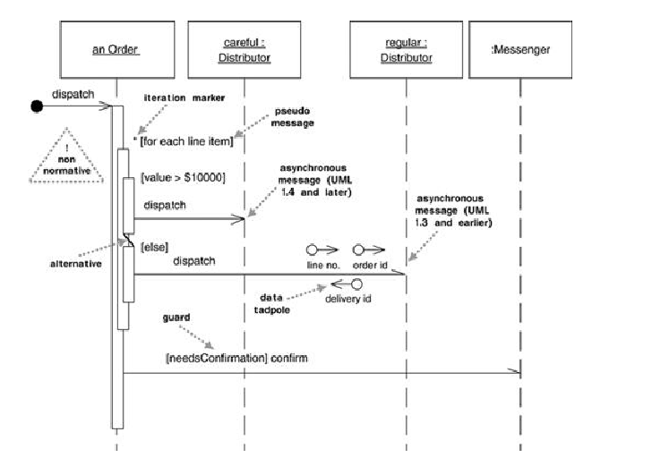

Slide 16
FRAME OPTION
alt Alternative multiple fragments; only the one whose condition is true will execute (Figure 4.4).
opt Optional; the fragment executes only if the supplied condition is true. Equivalent to an alt with only one trace (Figure 4.4).
par Parallel; each fragment is run in parallel.
loop Loop; the fragment may execute multiple times, and the guard indicates the basis of iteration (Figure 4.4).
region Critical region; the fragment can have only one thread executing it at once.
neg Negative; the fragment shows an invalid interaction.
ref Reference; refers to an interaction defined on another diagram. The frame is drawn to cover the lifelines involved in the interaction. You can define parameters and a return value.
sd Sequence diagram; used to surround an entire sequence diagram, if you wish.

Slide 17
COLLABORATION DIAGRAM
The sequence is indicated by numbering the message
the spatial layout allows you to show other things more easily
show how object link together
you can overlay packages or other information more easily

Slide 18
:Order Entry Window
object
1:prepare()
message
sequence number
:Order
5:needsReorder :=
needToReorder()
2: *[for all order lines]: prepare()
selfdelegation
Macallan Line: Order Line
Macallan Stock:StockItem
3:has Stock:=check()
6:[needsReoder]:new
4:[has Stock]:remove()
7:[hasStock]:new
:Delivery Item
:Reorder Item

Slide 19
SEQUENCE OR COLLABORATION?
different people have different preference
for different situation
interaction diagrams can awkward to use when exploring alternatives

Slide 20
HOW TO FIND METHODS (BEHAVIORS, OPERATIONS) OF OBJECT
好，你應該知道要怎麼樣以sequence diagram描述物件之間的互動
重點是，你的物件的 method 根本還沒有個譜？
你怎麼找他們？

Slide 21
9.2. THE KRB SEVEN-STEP METHOD.
STEP  OPERATIONS (I.E., BEHAVIOR)
Six techniques for
Finding Operations
1. By Inspection
2. Basic CRUD
3. Use Cases
4. Statechart Diagram
5. CRC Cards
6. CRUD Revisited

Slide 22
WHAT IS A USE CASE？
使用案例 （系統使用情境 scenario）
Use cases 是你的系統所要完成的功能
這些功能當然要由你所設計的 objects 互動來完成
請看上次的規格書

Slide 23
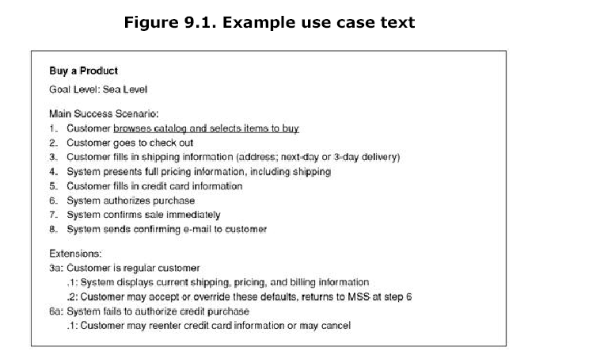

Slide 24
WHAT IS A SCENARIO (情境）
A scenario is a sequence of steps describing an interaction between a userand a system.
So if we have a Web-based on-line store, we might have a Buy a Product scenario that would say this:
The customer browses the catalog and adds desired items to the shopping basket. When the customer wishes to pay, the customer describes the shipping and credit card information and confirms the sale. The system checks the authorization on the credit card and confirms the sale both immediately and with a follow-up e-mail.

Slide 25
WHAT IS A USE CASE?
一個使用案例是一組（系統使用，或系統操作）情境來達成某個目標
一個趨勢是規格書的寫法漸漸由 use cases 所取代，尤其是軟體代工產業

Slide 26
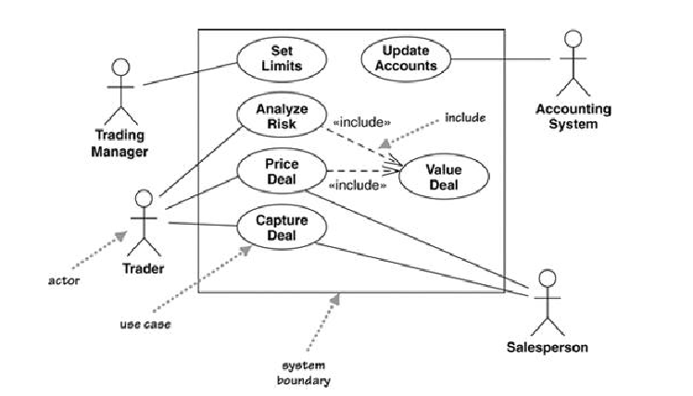
USE CASE DIAGRAM

Slide 27
USE CASE干尋找物件METHOD啥事
一旦有了 use case (可以有正式文件，或者是 建模者自行寫下一些scenario
Scenarios (use cases) 是系統行為的起頭
每一個use case 最終一定要由系統中的物件來完成
OK， 接著？

